Slide 1
Harris Corner Detector
By Vijaya Martin.A.R
(2023510005)

Slide 2
Harris Corner Detector
Harris Corner Detector is a corner detection operator that is commonly used in computer vision algorithms to extract corners and infer features of an image. It was first introduced by Chris Harris and Mike Stephens in 1988 upon the improvement of Moravec’s corner detector. It is a method to extract the corners from the input image and to extract features from the input image.

Slide 3
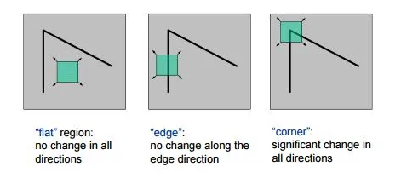
What are Corners?
A corner is a point whose local neighbourhood stands in two dominant and different edge directions.
In other words, a corner can be interpreted as the junction of two edges, where an edge is a sudden change in image brightness.
Corners are the important features in the image, and they are generally termed as interest points which are invariant to translation, rotation, and illumination.

Slide 4
The Harris Corner Detector is formulated as such:
E(u, v) = ∑ w(x, y)[I (x + u, y + v) − I (x, y)]²
x, y
Where ∑ w(x, y) is the Window Function
I (x + u, y + v) is the Shifted Intensity
And I (x, y) is the Actual Intensity
The above equation is used to quantify the change in intensity of the sliding window in the image.

Slide 5

But what does that mean?
When an image changes direction (i.e makes a corner) , there is a sudden change in intensity along its previous edge.
When we use a sliding window, this change in intensity becomes very apparent.
Corner!
Edge…
Edge…

Slide 6
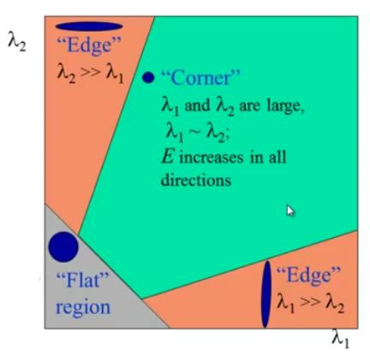
how does the algorithm know this?
When we apply the equation, we get a second moment matrix, from which we obtain two eigenvalues.
If one eigenvalue is larger than the other, it is an edge.
If both eigenvalues are small, it is a flat region.
If both eigenvalues are large and similar, then it is a corner.

Slide 7
How is the algorithm implemented?
The algorithm follows seven steps:
Convert to Grayscale
Compute Image Gradients
Compute Products of Derivatives
Apply Gaussian Filter
Compute Corner Response
Thresholding
Non-Maximum Suppression

Slide 8
Isn’t this very time-consuming to perform?
Yes, It is!
Which is why the cv2 library offers a pre-built function for instant use!
The cv2.CornerHarris function can be used to apply the Harris Corner Detection Algorithm without any preprocessing!

Slide 9
Is it actually useful?
Yes, It is! We may not be aware of it, but it is used in many fields and has many applications! Such as:
Image Matching and Stitching
Motion Tracking
3D Reconstruction
Object Recognition

Slide 10
Conclusion:
The Harris Corner Detector is still one of the most influential and broadly implemented computer vision techniques for the detection of interest points.
Through the detection of local image gradients using the structure tensor, it is able to robustly detect corners—areas of high intensity variation in many different directions.
Its rotation invariance and computational simplicity mean it is particularly well-suited to applications such as feature matching, motion tracking, and object recognition.

Slide 11
Thank You for Reading!!!

